Slide 1
Internal Combustion Engines: Air standard cycles – Otto and Diesel cycles, working of two stroke and four stroke Petrol and Diesel engines, Carburatted and MPFI engines, fuel pump, fuel injector, ignition system, cooling system, lubricating system.
Module 2
Refrigeration & Airconditioning: Introduction to refrigeration and air -conditioning, Rating of refrigeration machines, Coefficient of performance, Simple refrigeration vapour compression cycle, summer and winter air conditioning.

Slide 2
Air standard cycles
Air standard cycle is an idealised cycle in which air is taken as the working fluid
Air standard cycles can be used for comparing the
performance of real internal combustion engine
Air Standard Efficiency
A hypothetical efficiency calculated from the ideal air standard cycle, in order to compare the efficiency of various cycles is called air standard efficiency or ideal thermal efficiency

Slide 3
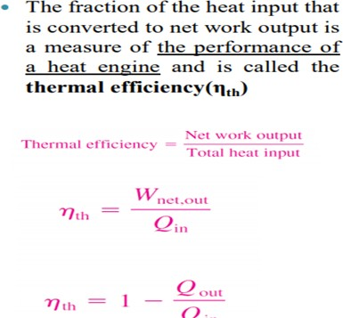
Ideal thermal efficiency of an air standard cycle may be defined as the ratio of net work done to the heat supplied during the cycle

Slide 4
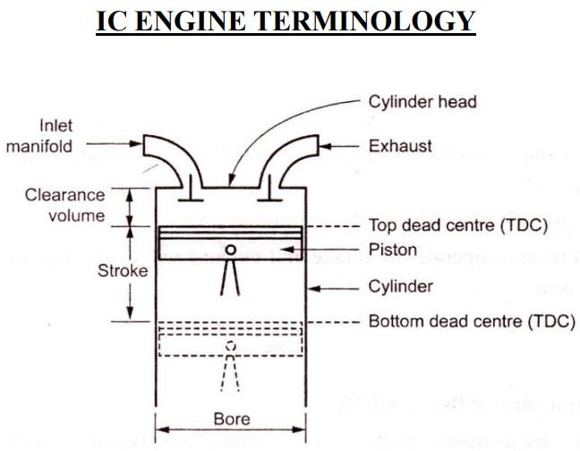

Slide 5
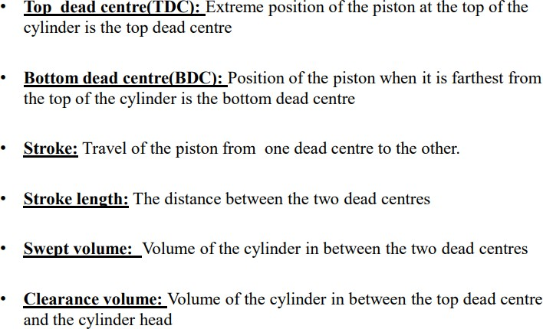
•
Bore the internal diameter of the cylinder of the engine is called bore

Slide 6
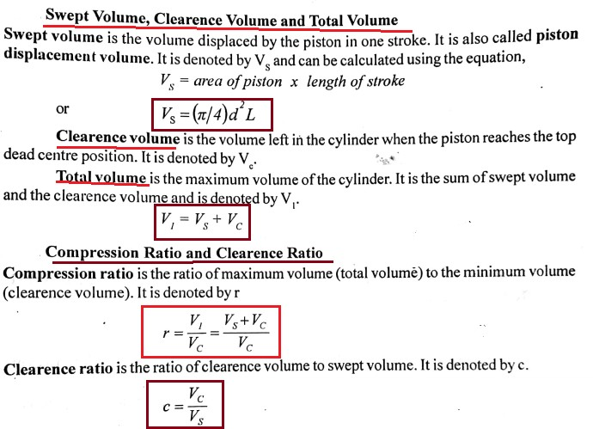

Slide 7
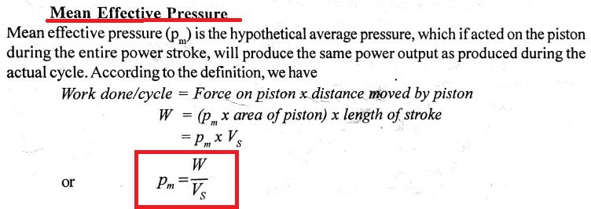

Slide 8
OTTO CYCLE
The Otto cycle is the ideal cycle for spark-ignition reciprocating(Petrol) engines. It is named after Nikolaus A. Otto, who built a successful four stroke engine in 1876 in Germany using the cycle proposed by Frenchman Beau de Rochas in 1862
Otto cycle forms the basis for the petrol engine
The cycle is:
1-2: Isentropic compression
2-3: Heat addition at constant volume 3-4: Isentropic Expansion
4-1:Heat rejection at constant volume

Slide 9
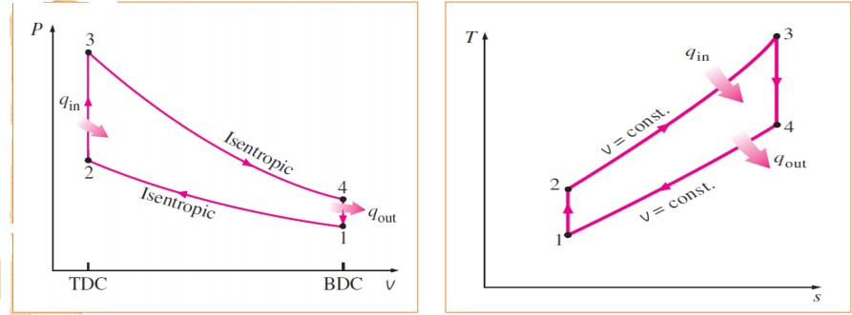
p-V & T-S diagram

Slide 10
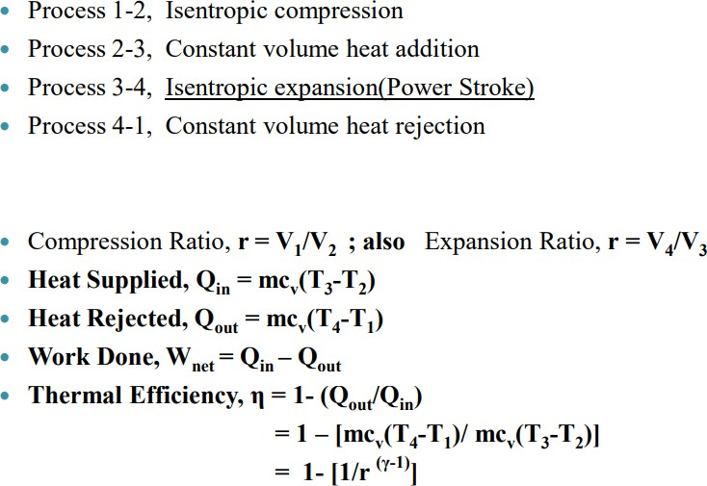

Slide 11
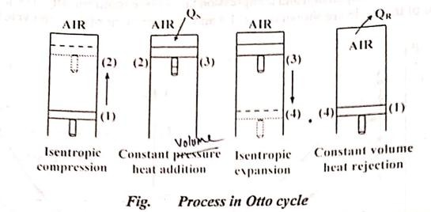

Slide 12
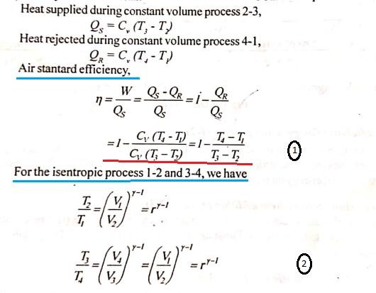
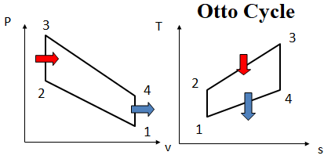


Slide 13
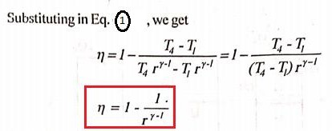

Slide 14
DIESEL CYCLE
The Diesel cycle is the ideal cycle for Compression Ignition(CI) reciprocating engines. The CI engine, first proposed by Rudolph Diesel in the 1890s
Diesel cycle forms the basis for the diesel engine
The cycle is:
1-2: Isentropic compression
2-3: Heat addition at constant pressure 3-4: Isentropic Expansion
4-1:Heat rejection at constant volume

Slide 15
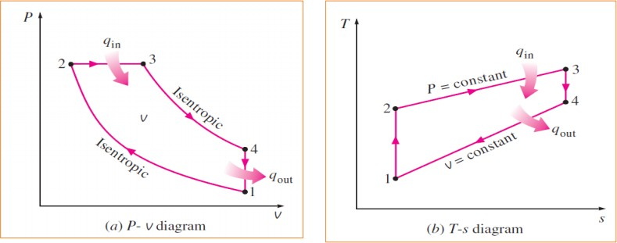
p-V & T-S diagram

Slide 16
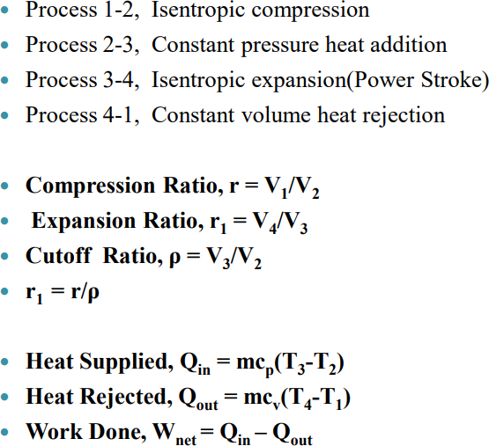

Slide 17
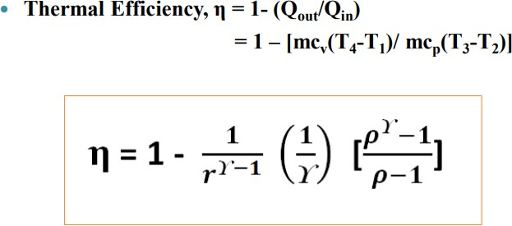

Slide 18
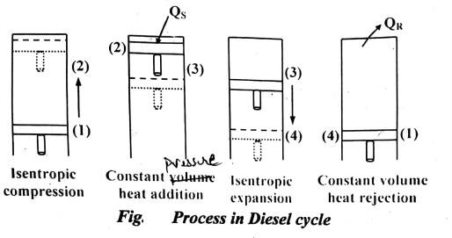

Slide 19
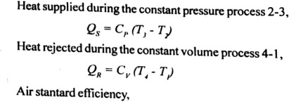
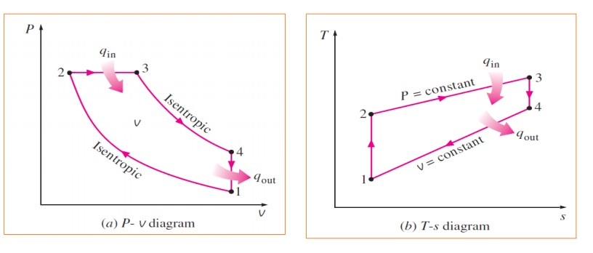
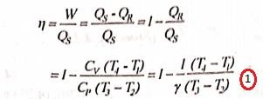

Slide 20
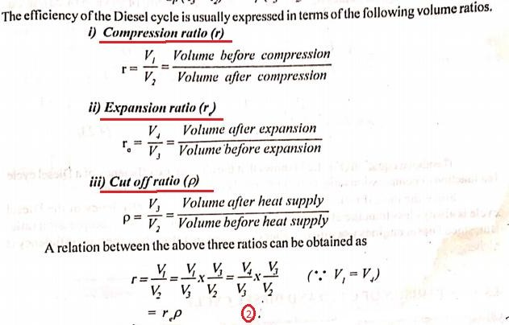

Slide 21
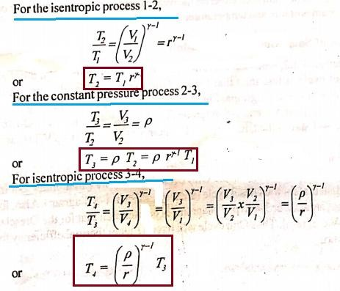

Slide 22
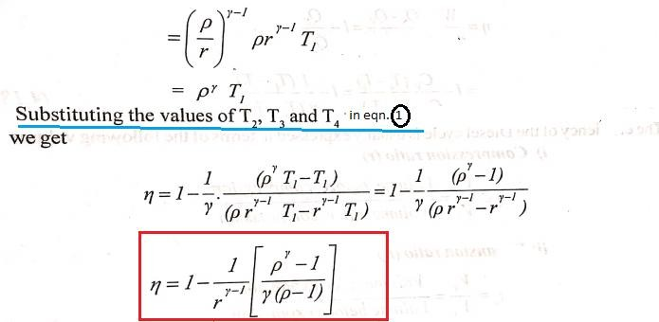

Slide 23
